Slide 1

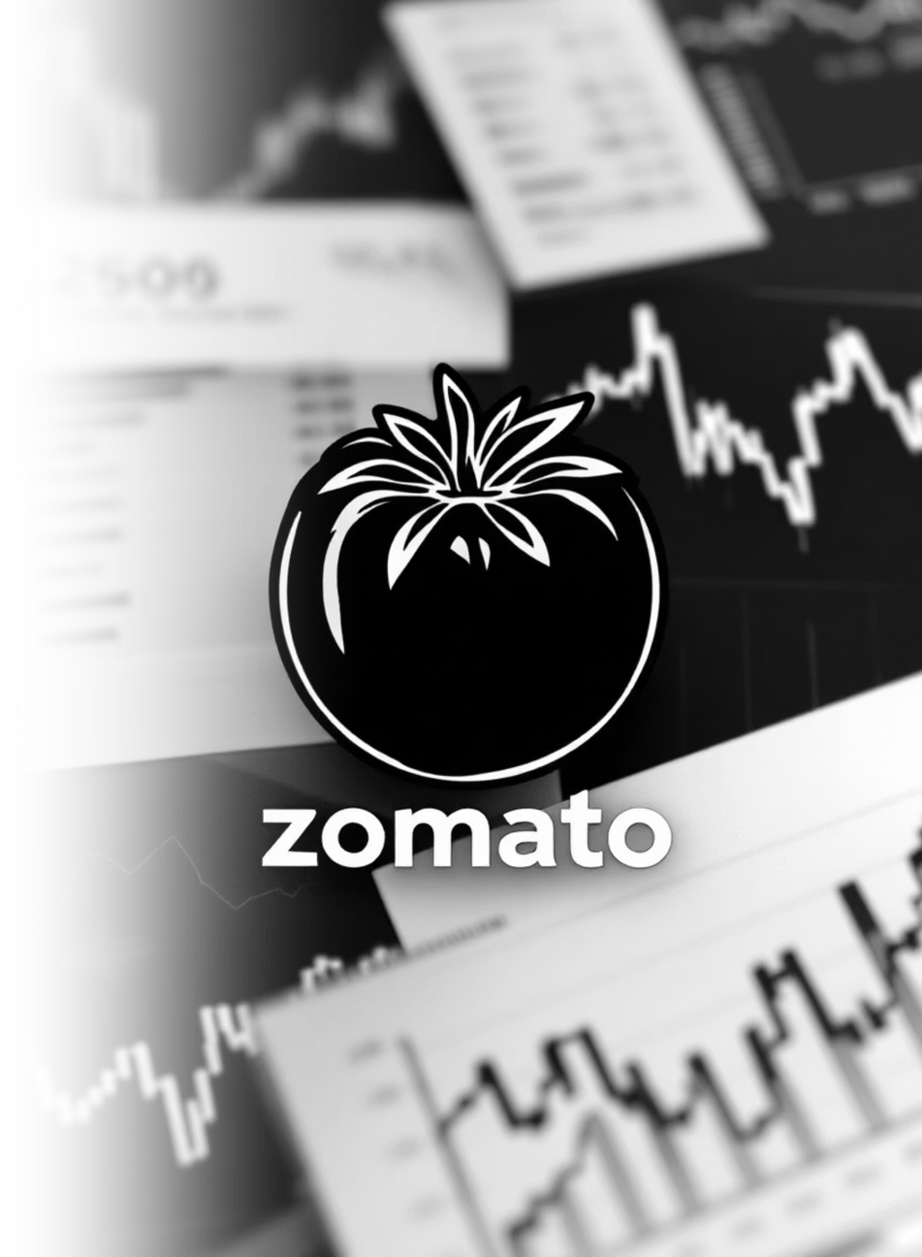
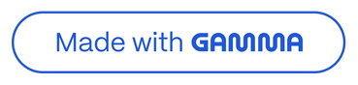
ZOMATO LIMITED
Financial Analysis & Business Model Evaluation
FY23 - FY25
Prepared by: Ayush Singh Date: January 2026
Notes:
1

Slide 2
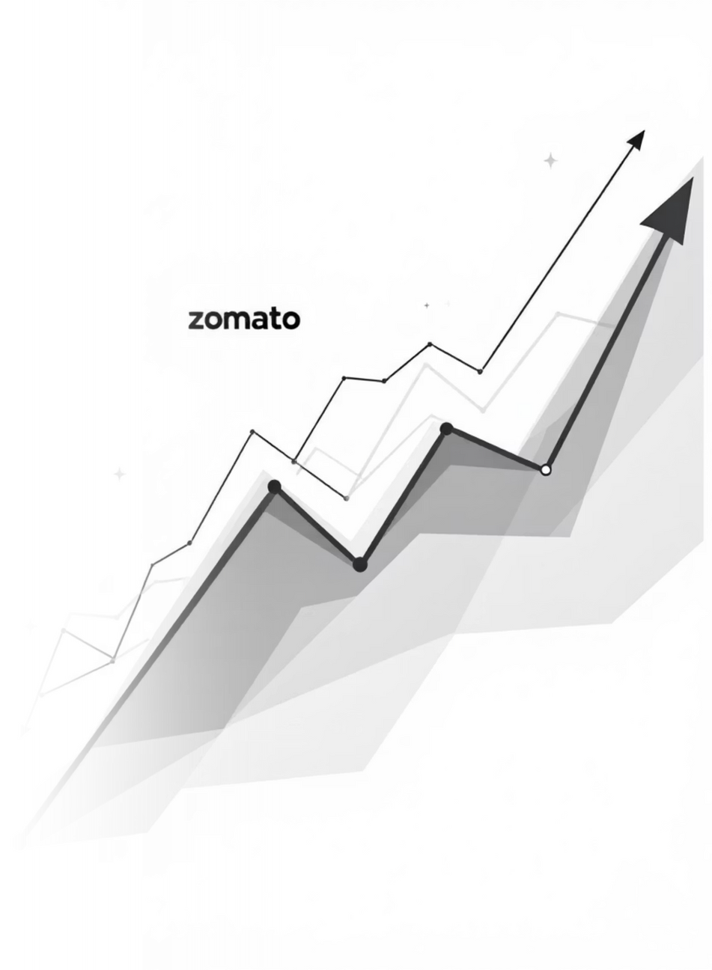
EXECUTIVE SUMMARY
The Turnaround Story
1
Financial Growth
Revenue +83%, EBITDA +794%, PAT +1,576% over 3 years.
2
Profitability
EBITDA Margin improved by 21.2 percentage points.
3
Market Leadership
Over 50% market share in food delivery.
4
Strong Balance Sheet
Debt-free with ₹34,115 Cr equity and strong cash generation.
Rating: BUY
Strong fundamentals, expanding ecosystem.
Notes:
2

Slide 3
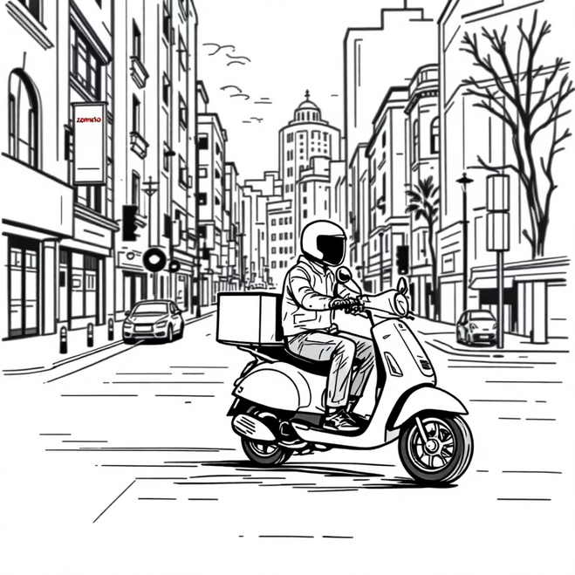
BUSINESS MODEL CANVAS
How Zomato Makes Money
Revenue Streams (Estimated Mix - FY25)
Platform Economics
Food Delivery: 65% (₹5,600 Cr) - Commission, Delivery, Ads, Gold Subs
Network Effect: More restaurants attract more customers and partners.
Quick Commerce (Blinkit): 25% (₹2,150 Cr) - Product Margins, Delivery
Negative Working Capital: Collects from customers 26 days before paying restaurants.
Hyperpure & Going-Out: 10% (₹867 Cr) - B2B Supply, Dining Reservations
High Operating Leverage: 70% variable costs allow margin expansion.
Asset-Light Model: Minimal capex, high ROCE potential.
Competitive Moat
Brand recognition & trust
Largest delivery network
Technology & data advantage
Notes:
3

Slide 4
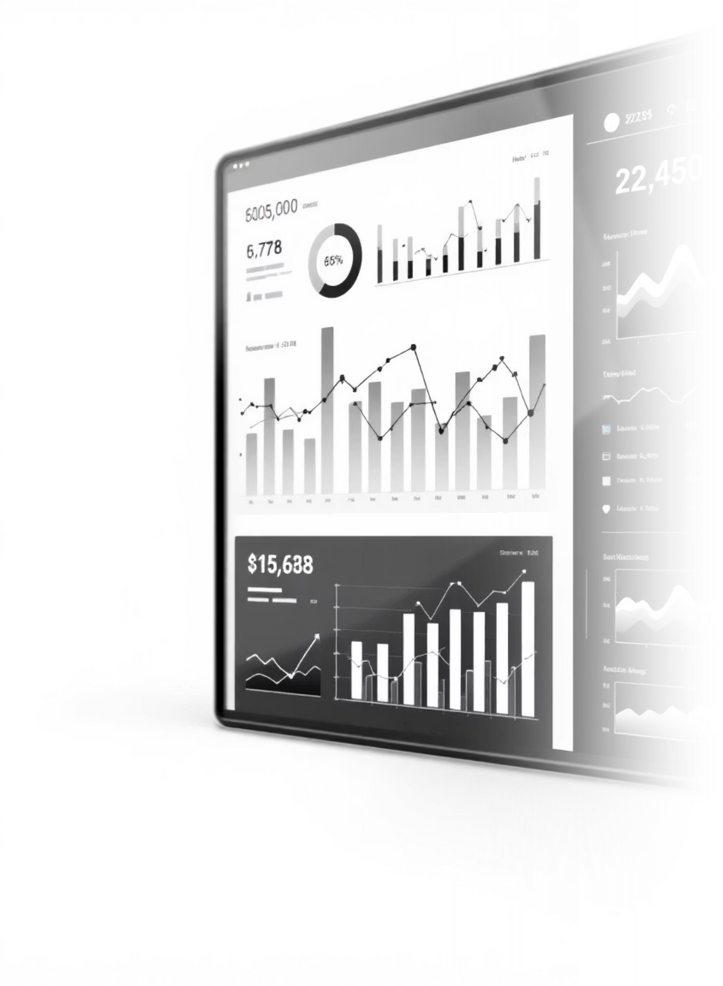




FINANCIAL PERFORMANCE DASHBOARD
Key Metrics Trend
Revenue Growth
FY23: ₹4,707 Cr to FY25: ₹8,617 Cr (35.4% CAGR).
Profitability Explosion
EBITDA Margin: 5.5% to 26.7%. PAT: ₹117 Cr to ₹1,960 Cr (17x growth).
Balance Sheet Strength
Total Equity ₹34,115 Cr, Debt/Equity 0.005, Current Ratio 4.12.
Cash Generation
Operating Cash Flow grew to ₹1,614 Cr in FY25.
Notes:
4

Slide 5

PROFITABILITY DEEP DIVE
Margin Expansion Analysis
EBITDA Bridge (FY23 to FY25)
Cost Structure Evolution (% of Revenue)
FY23 EBITDA: 5.5%
+ Scale Economics: +8.0pp
Variable Costs
69%
64%
⬇️
+ Reduced Discounting: +5.0pp
+ Delivery Efficiency: +4.2pp
Employee
24%
15%
⬇️
+ Product Mix: +3.0pp
- Competitive Pressure: -1.0pp
Fixed Costs
7%
10%
➡️
+ Other: +2.0pp
FY25 EBITDA: 26.7%
EBITDA Margin
5%
27%
⬆️
Key Insight: Achieved operating leverage; every incremental rupee of revenue contributes 27 paise to EBITDA.
Notes:
5

Slide 6
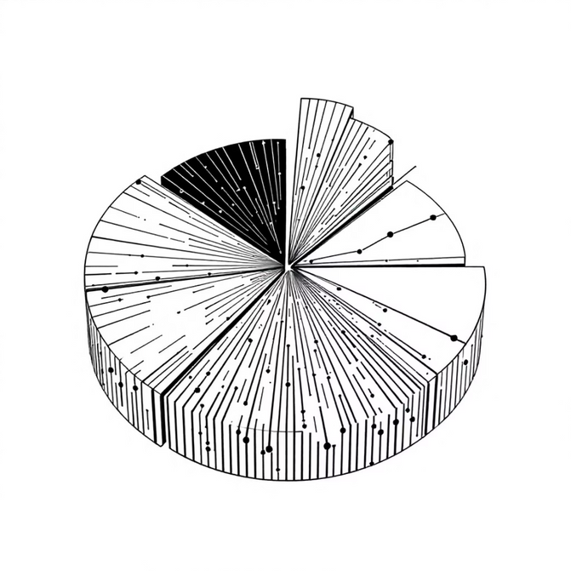
BALANCE SHEET ANALYSIS
Financial Position Overview (₹ Crores)
Assets Composition - FY25
Equity & Liabilities - FY25
Total Assets: ₹35,851 Cr
Total: ₹35,851 Cr
Non-Current Assets (82%): ₹29,540 Cr (Investments in Subsidiaries: ₹24,431 Cr)
Equity (95%): ₹34,115 Cr
Liabilities (5%): ₹1,736 Cr
Current Assets (18%): ₹6,311 Cr (Cash & Bank: ₹1,799 Cr, Investments: ₹1,442 Cr)
Key Observations
✅ Debt-Free: Only ₹173 Cr lease liabilities.
✅ Liquidity Fortress: ₹3,240 Cr in liquid assets.
✅ Strategic Investments: ₹24,431 Cr in Blinkit, Hyperpure, etc.
Capital Efficiency: Need to improve ROIC on deployed capital.
Notes:
6

Slide 7
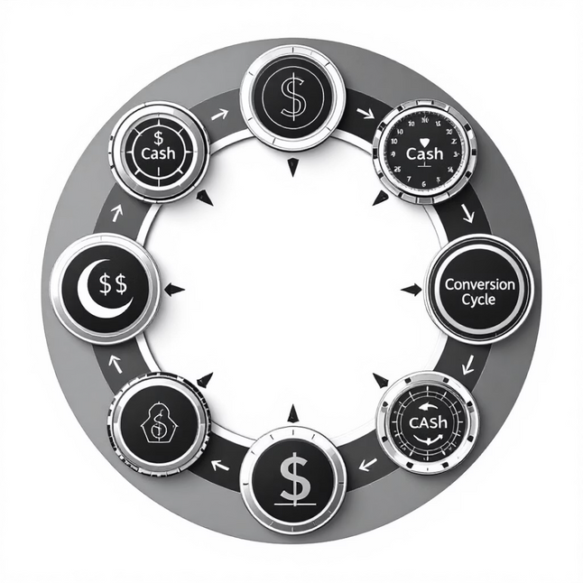
WORKING CAPITAL & CASH FLOW
Cash Conversion Excellence
Working Capital Cycle
Cash Flow Summary (₹ Crores)
DSO (Days Sales Outstanding): 5 days
Operating
224
1,614
✅ Strong
DIO (Days Inventory): 0 days
DPO (Days Payables): 31 days
Investing
(382)
(9,752)
🔄 Growth
CCC (Cash Conversion Cycle): -26 days
Financing
(14)
8,388
💰 QIP
Zomato collects from customers 26 days before paying restaurants, creating a natural cash float.
FY25 Highlights
QIP Fundraise: ₹8,501 Cr
Subsidiary Investments: ₹5,442 Cr
Free Cash Flow: Turned positive.
Notes:
7

Slide 8
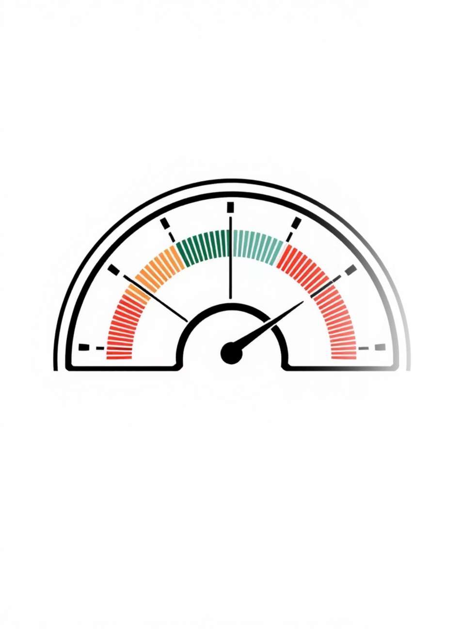
RATIO ANALYSIS & FINANCIAL HEALTH
Comprehensive Scorecard
Liquidity Ratios EXCELLENT
Current Ratio: 4.12 (>1.5)
Quick Ratio: 4.12 (>1.0)
Cash Ratio: 2.12 (>0.5)
Profitability Ratios STRONG
EBITDA Margin: 26.7% (Target 20%+)
Net Margin: 22.7% (Target 15%+)
ROE: 6.1% (Target 15%+)
Leverage Ratios CONSERVATIVE
Debt/Equity: 0.005 (<1.0)
Interest Coverage: 137x (>3.0)
Efficiency Ratios IMPROVING
Asset Turnover: 0.28x (Low, investment phase)
Receivables Days: 5 days (Excellent)
Payables Days: 31 days (Balanced)
Overall Financial Health: 8.5/10
Notes:
8

Slide 9

RISKS & MITIGATION STRATEGIES
Risk Assessment Matrix
High Priority: Competition Intensity
Threat: Swiggy, Zepto, Amazon.
Mitigation: Scale, brand moat, quick commerce dominance.
High Priority: Regulatory Changes
Threat: Gig worker classification, min wage.
Mitigation: Flexible model, government engagement.
Medium Priority: Unit Economics
Threat: Growth slowdown affecting profitability.
Mitigation: Diversification (Blinkit, Going-Out).
Medium Priority: Tech Disruption
Threat: Drone delivery, D2C models.
Mitigation: Continuous innovation, value-adds.
Notes:
9

Slide 10





STRATEGIC RECOMMENDATIONS
Path to Enhanced Value Creation
Improve Capital Efficiency
Action: Accelerate revenue from Blinkit investments.
Target: ROE to 10%+ by FY26.
Margin Protection
Action: Focus on profitable geographies, optimize delivery costs.
Target: Maintain 25%+ EBITDA margin.
Going-Out Business Acceleration
Rationale: Higher margins, lower competition, lifestyle stickiness.
Target: 20% of revenue from Going-Out by FY27.
Tier 2/3 Expansion
Market: 300+ cities with <10% penetration.
Target: 30% revenue from non-metro by FY27.
Super-App Ecosystem
Vision: Integrate food, grocery, dining, experiences, payments.
Goal: Build customer LTV from ₹5,000 to ₹15,000+.
Notes:
10

Slide 11
Investment Conclusion: Attractive Opportunity
Zomato presents a compelling investment case, balancing strong market position with growth potential.
Bull Case Drivers ⬆️
Bear Case Considerations ⬇️
Market Leadership (50%+ share)
Intensifying Competition
Proven Profitability (26.7% EBITDA margin)
Regulatory Risks (Gig economy laws)
Debt-free with ₹3,240 Cr cash
ROE Below Target (6.1%)
Quick Commerce 3x potential
Growth Moderation (from 40%+ to 30%)
Expanding Operating Leverage
Strategic Ecosystem (Blinkit, Hyperpure)
Valuation Framework
Trading at a premium justified by growth and market position.
8-10x
30-35x
40-45x
Price-to-Sales
EV/EBITDA
P/E
FY25 revenue (₹8,617 Cr)
On ₹2,298 Cr EBITDA
On ₹1,960 Cr PAT
"Zomato has executed a remarkable turnaround from loss-making to 27% EBITDA margins while maintaining market leadership. Overall, a compelling investment in India's platform economy."
Notes:
1

